Slide 1
Exploratory Data Analysis (EDA) on Play Store App Review Analysis Team Members Ajay Pedhekar Narendra Ghodse Uday Firake Saurabh Kumar Sandhya kumari Sah
Capstone Project 1

Slide 2

1) Introduction 2) Problem Statement 3) Data Summary 4) Data Exploration 5) Data Cleaning 6) Data Visualization 7) Conclusion
Contents

Slide 3
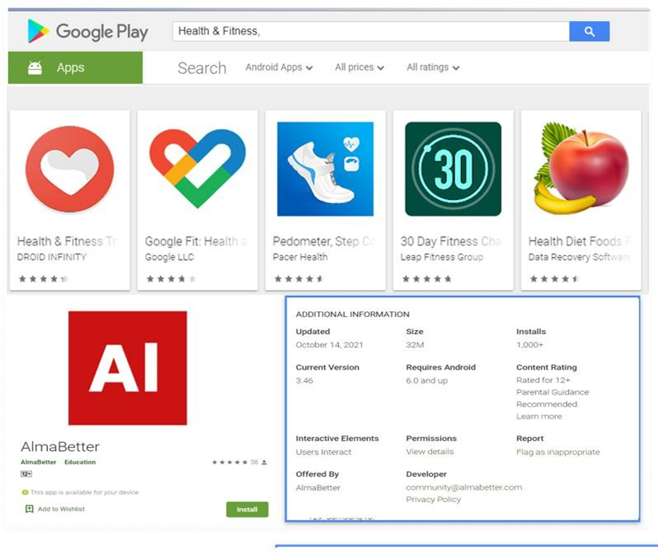
Introduction
Google Play Store and formerly Android Market, developed by Google. It serves as the official app store for certified devices running on the Android operating system, It is allowing users to browse and download applications developed with the Android software development kit (SDK) and published through Google.
Google Play also serves as a digital media store, offering music, books, movies, and television programs.
It is the largest and most popular Android app store with around three million different apps available for the users to download.

Slide 4
Problem Statement
The Play Store apps data has enormous potential to drive app-making businesses to success. Actionable insights can be drawn for developers to work on and capture the Android market.
Each app (row) has values for category, rating, size, and more. Another dataset contains customer reviews of the android apps.
Explore and analyze the data to discover key factors responsible for app engagement and success.

Slide 5
Data Summary
A. Play store Dataset
This file contains data of the Play store applications. It contains 10,841 rows of data with different application names and following columns:
App: It defines names of different applications to be reviewed.
Category: Category of the application it belongs to such as family, game, beauty,
business, entertainment, education...etc.
Rating: Overall user rating of the application. The users have rated the app out of 5,
with 1 being the lowest rating and 5 being the highest.
Reviews: The number of user reviews each app has received.
Size: The memory size needed to install the application.
Installs: The number of times each application has been installed by users.

Slide 6
Data Summary (Cont’d)
Type: Tells about the Free or paid version of the app.
Price: Notifies the price of the app.
Content Rating: This column specifies the intended audience of the app such as
teens, mature 21+, or everyone.
Genres: The sub-category for each app. Example: for the Education category, this
could be Education: Pretend Play, for example.
Last Updated: Release date of the most recent update for the app.
Current Ver: The app's current version.
Android Ver: The oldest version of Android OS supported by the app.

Slide 7
Data Summary (Cont’d)
B. User Reviews Dataset
This dataset contains the result of the sentiment analysis. It has 64,295 rows
of data with the following additional attributes:
App: Name of the applications.
Translated Review: Either the original review in English, or a translated version if the original review is in
another language. Moreover, the text in each review was pre-processed and
attributed with three new features.
Sentiment: The result of the sentiment analysis conducted on a review dataset. The value is either
Positive, Neutral, or Negative.
Sentiment Polarity: Sentiment polarity is a value indicating the positivity or negativity of the sentiment. It
ranges from -1 (most negative) to 1 (most positive).
Sentiment Subjectivity: Sentiment Subjectivity is a value ranging from 0 to 1, which indicates the
subjectivity of the review. Here, lower values indicate the review which is based
on factual information, and higher values indicate the review that is based on
personal opinions, public opinions or judgements.

Slide 8
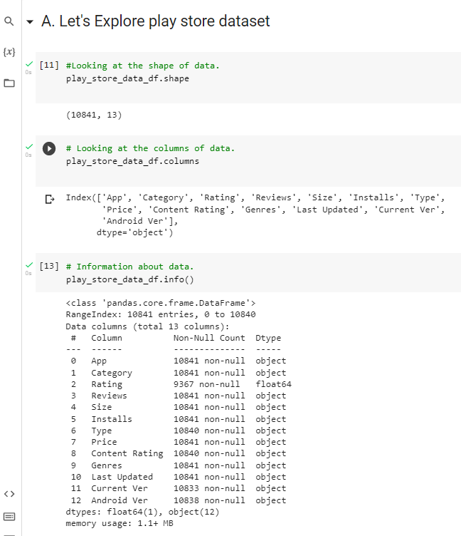
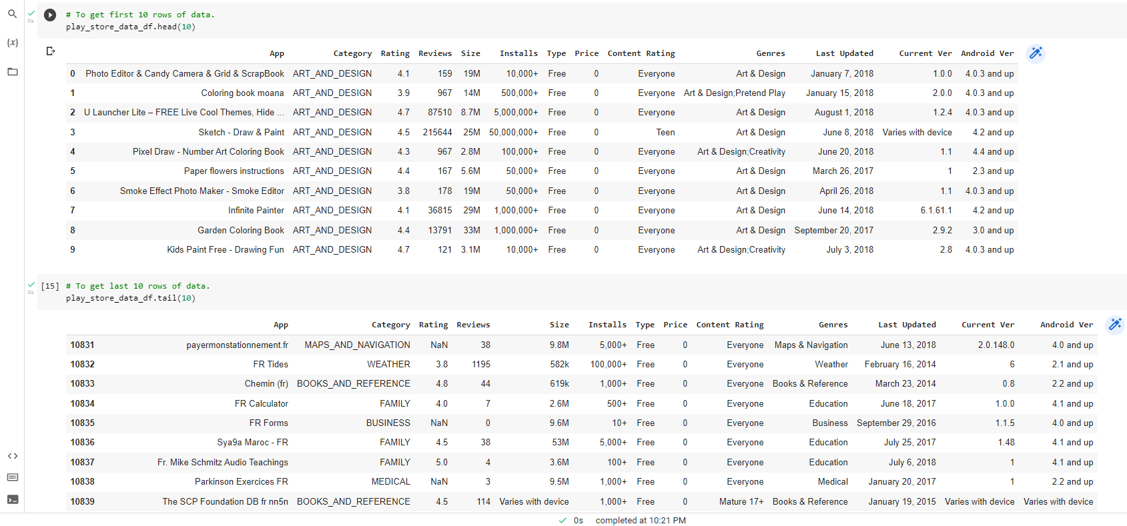
Data Exploration

Slide 9
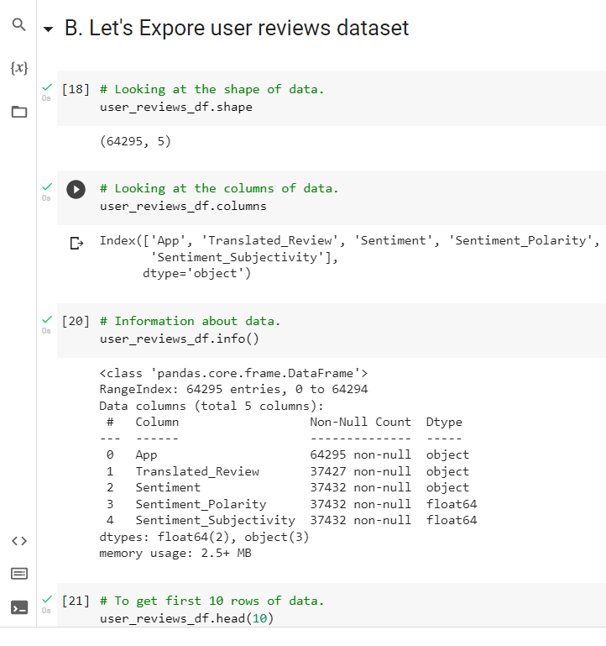
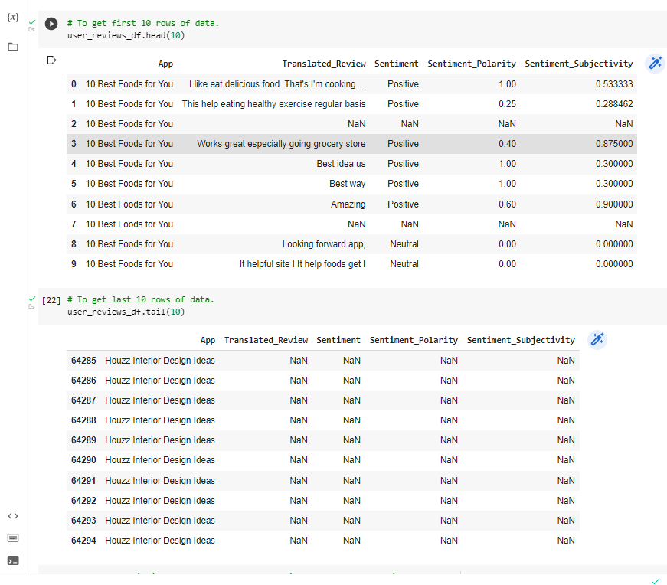
Data Exploration (Cont’d)

Slide 10
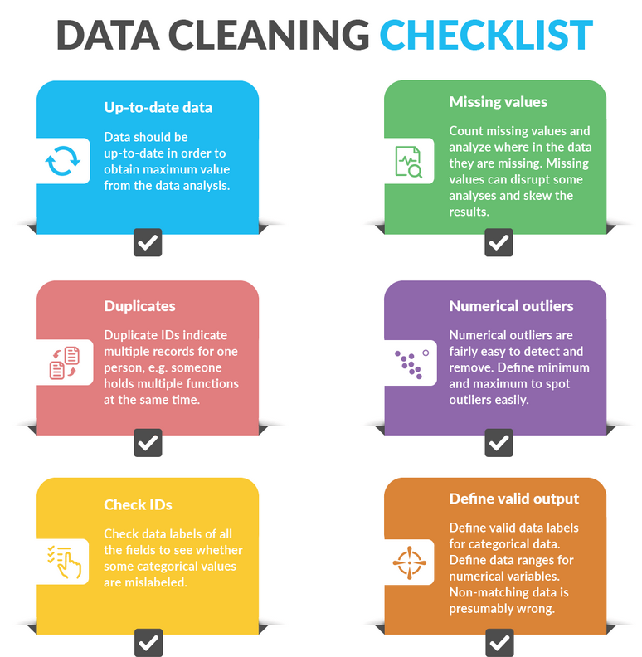
Data Cleaning

Slide 11
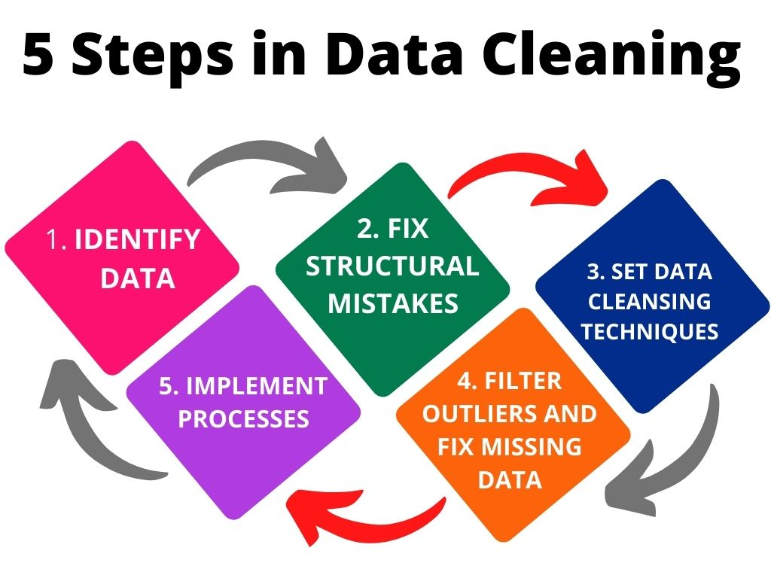
Data Cleaning (Cont’d)

Slide 12
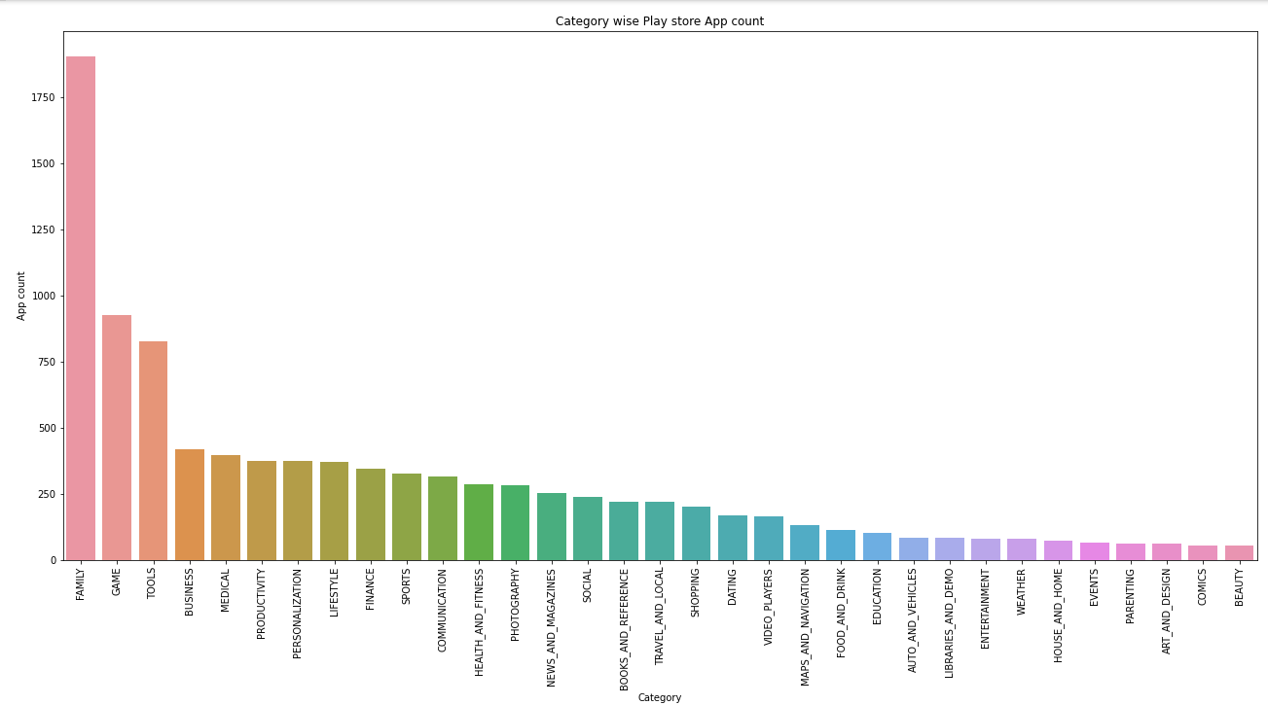
Data Visualization
The number of apps in each category.
As we can see the plot maximum no. of apps present in the play store are comes under Family,
Games and Tools Category.
And minimum no. of apps are present in Comics, Art and design, Beauty category.

Slide 13
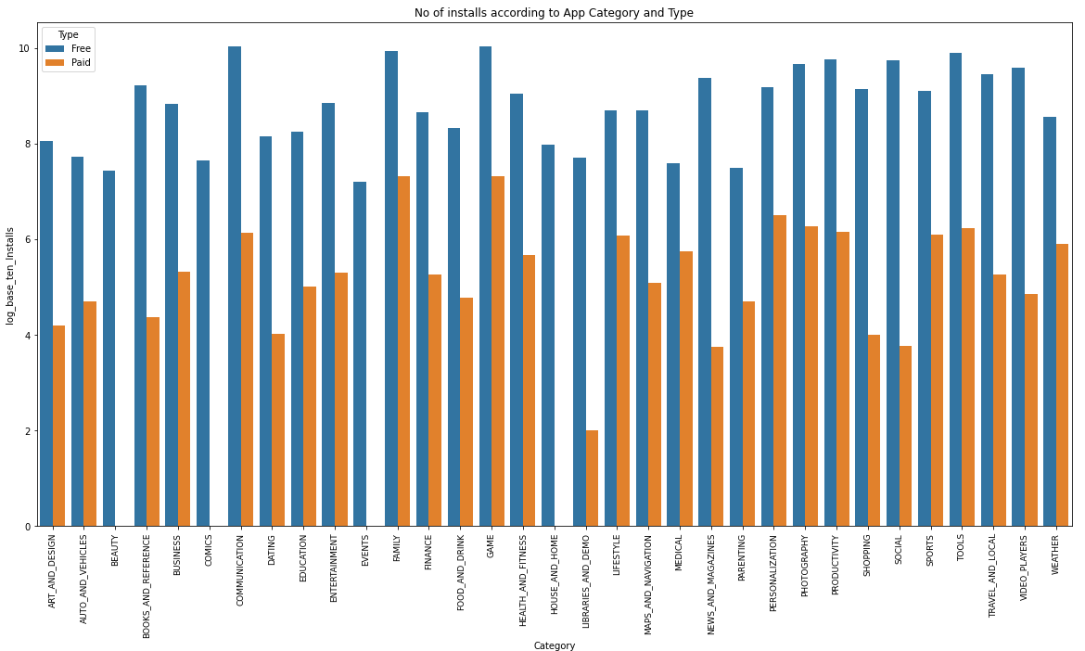
Comparing Category And App Type (Fee, Paid) by count of installs.
We can deduce that The Game, Communication, Tools and Family
category has the highest number of Installation.

Slide 14
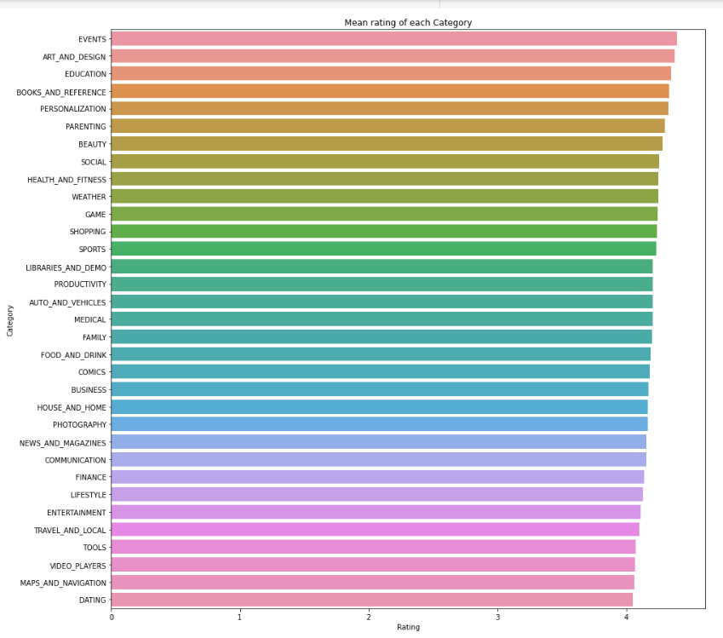
. The average rating of each category
In the given plot we can say that maximum average rating is high for Event, Art and design, Education and Books
category apps . The minimum average rating for Dating, Maps and navigation, Video players and Tools category apps.

Slide 15
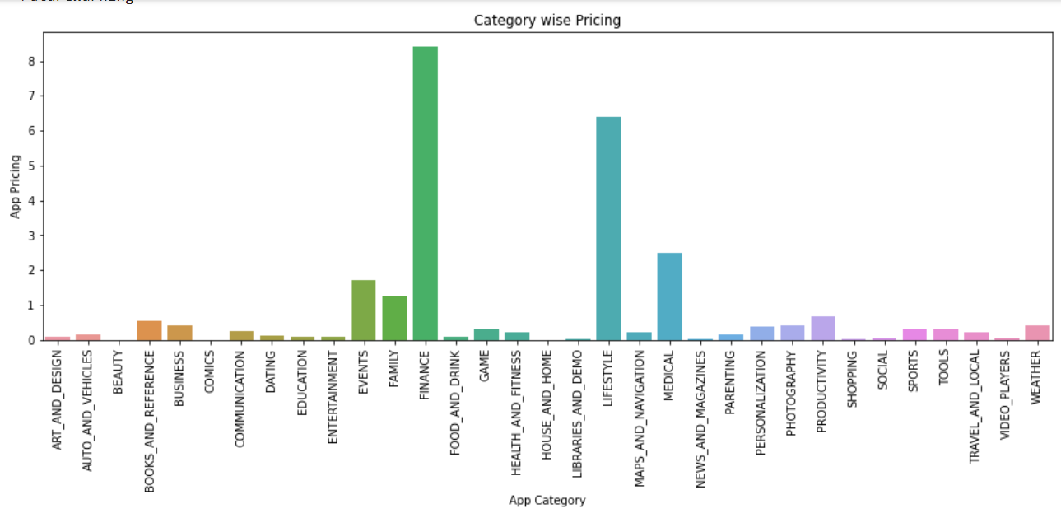
Category Wise Pricing Visualization.
The majority of apps except Finance, Lifestyle, Events & Medical, Family
categories were free to install.
Lifestyle, Finance, and Medical categories had the biggest number of paid
apps available for download.

Slide 16
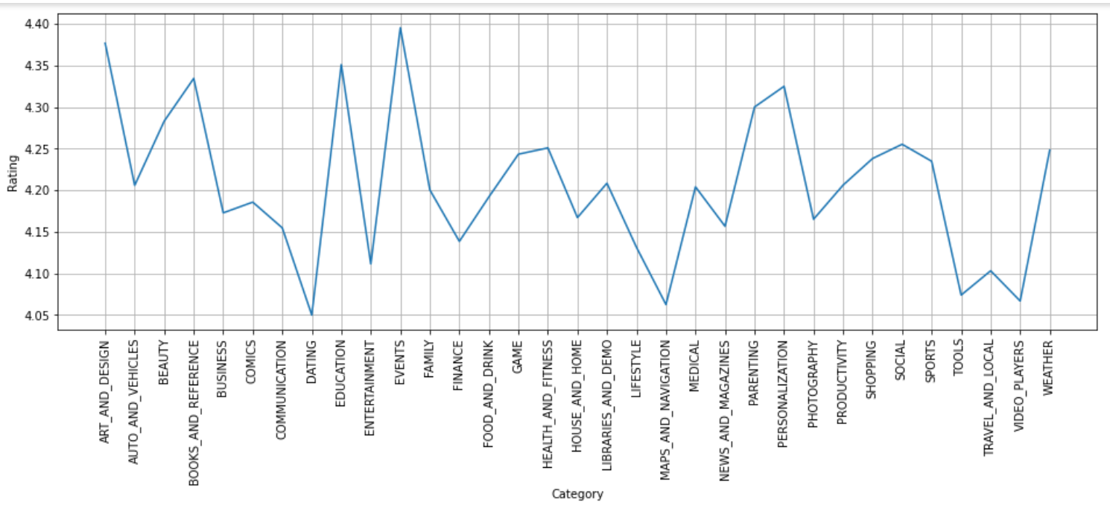
Rating visualization of Apps for given Category.
A. Highest Ratings apps :
Events, Art and Design, Education, Books and reference categories has got 4.3 and above ratings.
B. Lowest Ratings apps :
Dating, Maps and navigation, Video players, Tools category has got lowest ratings.

Slide 17
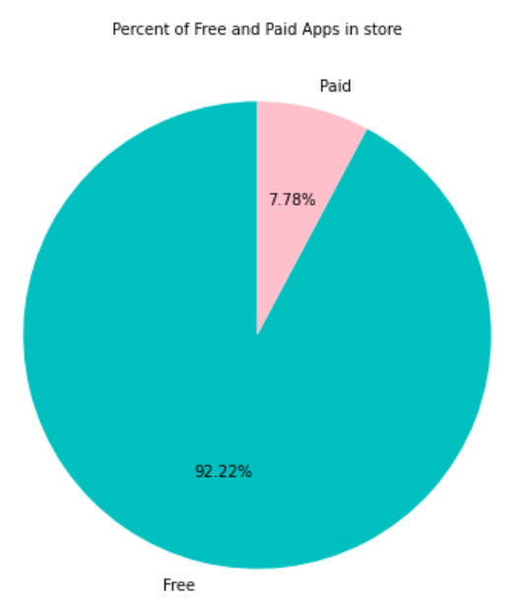

Percentage of free vs paid apps in play store
Here we can see that there are 92.22% of apps are free and only 7.78% of Apps are paid on Play store.

Slide 18
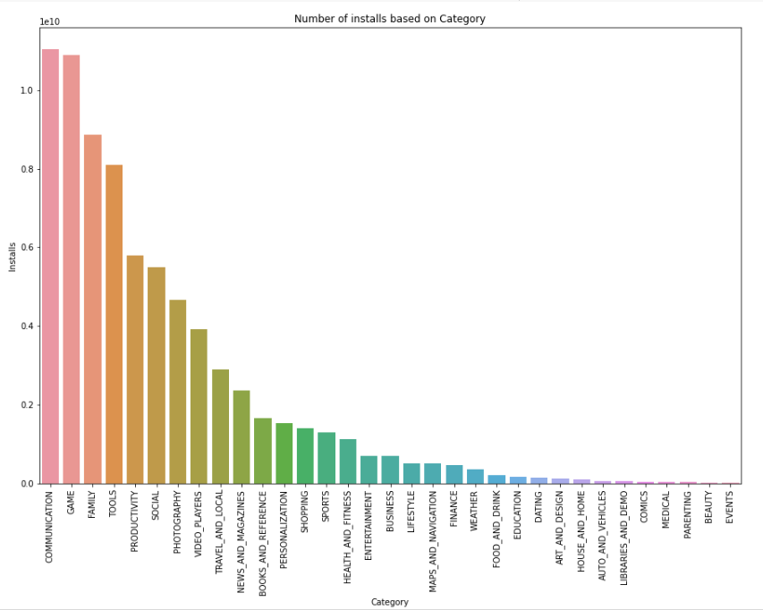
The Number of Apps Installs based on Category.
As we can see, the Maximum number of apps present in google play store comes under
Communication, Family & Games Category.
But as per the installation and requirement in the market plot, scenario is not the same. Here
maximum installed apps comes under Games, Communication, Family and Tools.

Slide 19
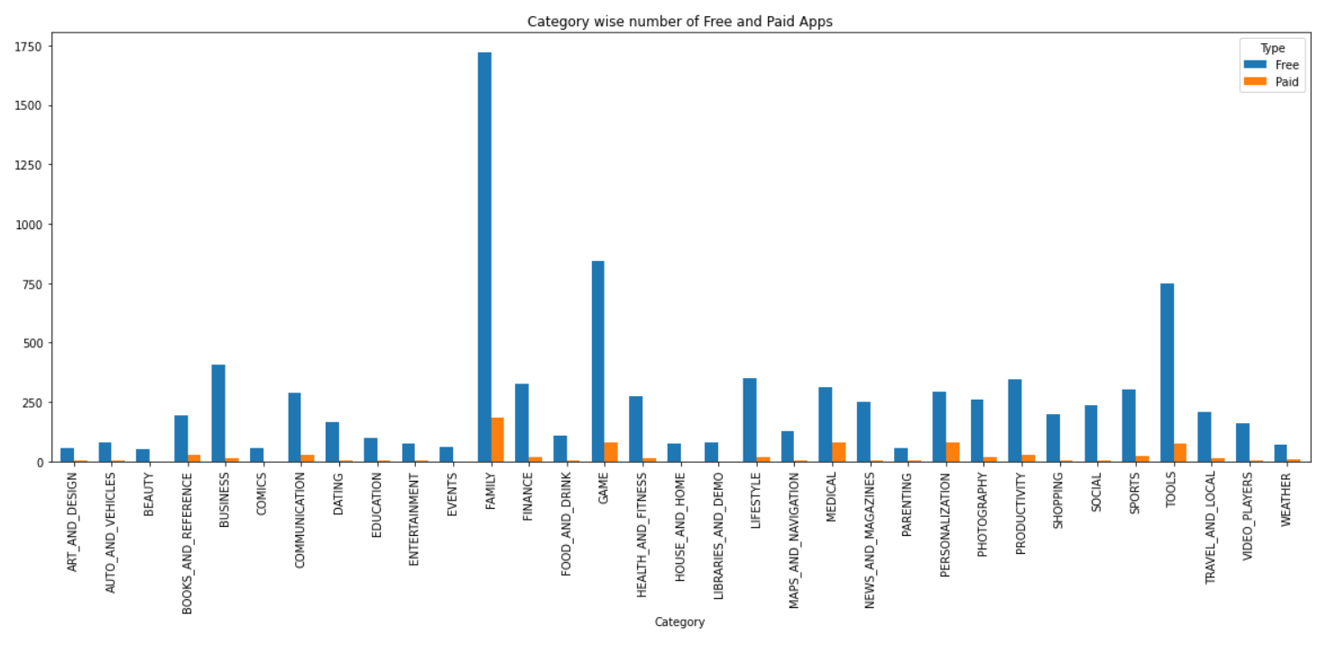
The number of free and paid apps category wise.
In the given plot we can say that maximum free apps are Family, Tools, business and Games category apps.
And the higher paid apps are also Family, Games, Medical and Tools category apps.

Slide 20
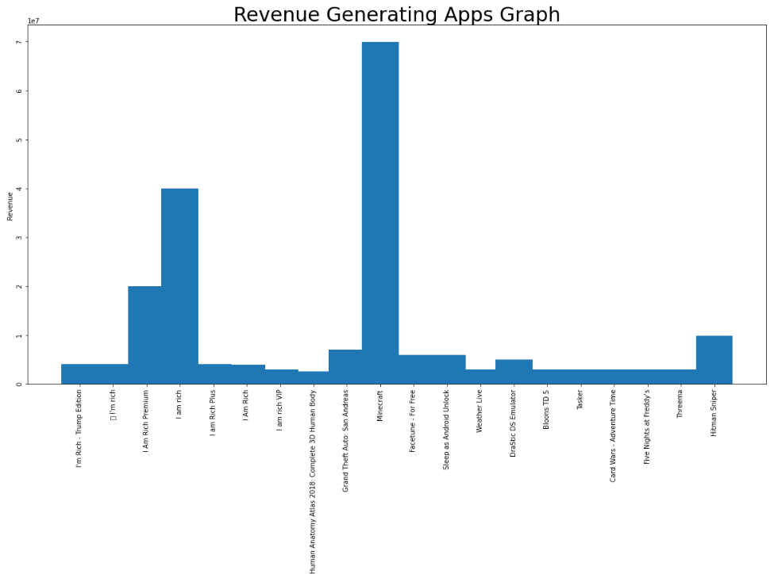
Graph of Revenue for given Apps.
The majority of apps, which generate revenue is between 2 to 8 million .
Minecraft is generating highest revenue among all, which is about 7 million.

Slide 21
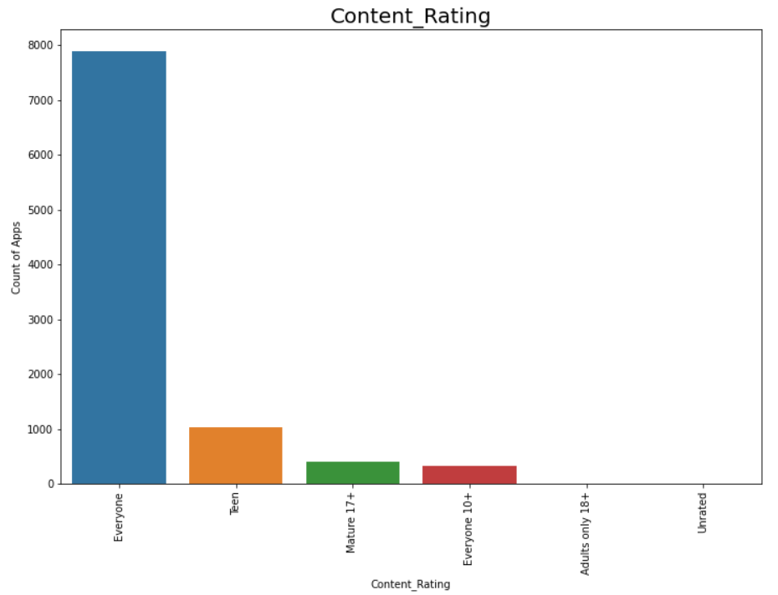
The Number of Apps Installs based on Category.
we can see from the graph that most of the apps are for “everyone” (Approx. 7900)
so that it could capture the most of the customer-base.
As we can see the plot minimum no. of apps are in google play store comes under Unrated, Adults only 18+ content rating.

Slide 22
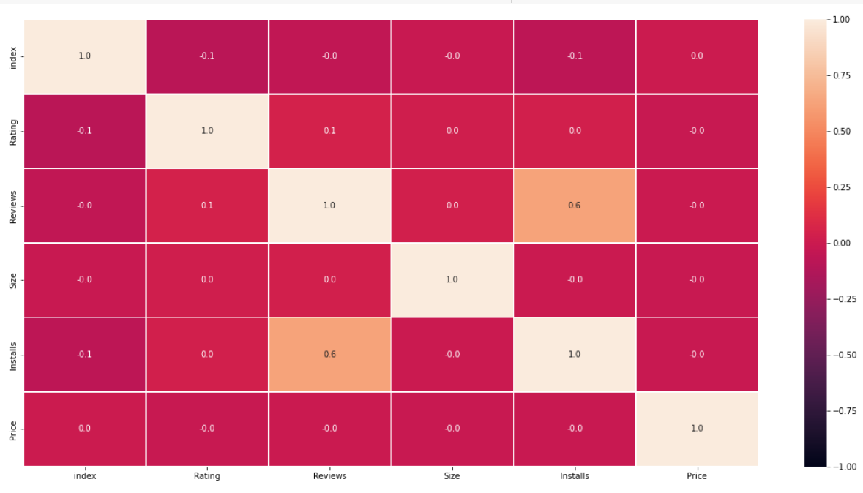
Correlation Between Different Parameters
Correlation is a statistical measure that indicates the extent to which two or more variables fluctuate together.
In simple terms, it tells us how much does one variable changes for a slight change in another variable.
It may take positive, negative and zero values depending on the direction of the change.
We can see that installs and reviews have the strongest correlation.

Slide 23
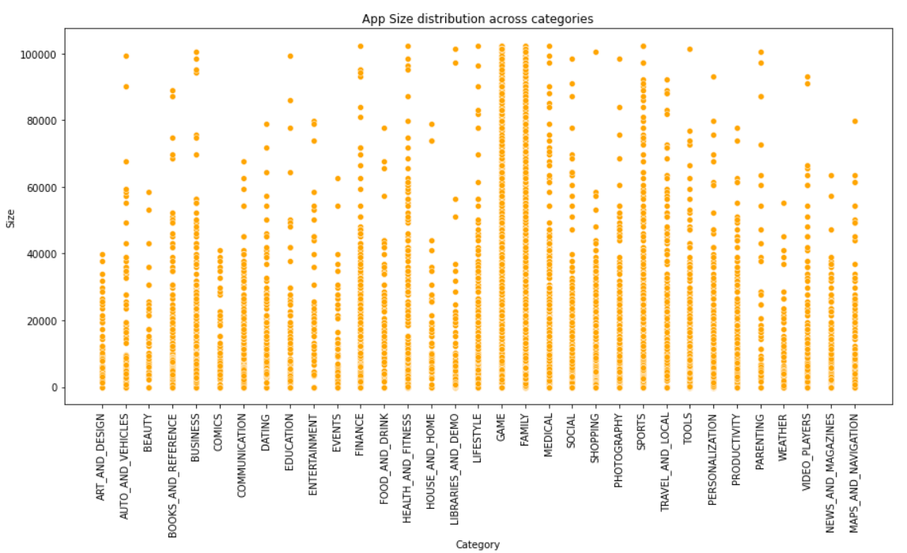
The distribution of Size across different Category.
As we see the scatter plot we can say that maximum no. of apps size distribution
on Family, Games and Sports.
Most of users preferred less MB size apps.

Slide 24
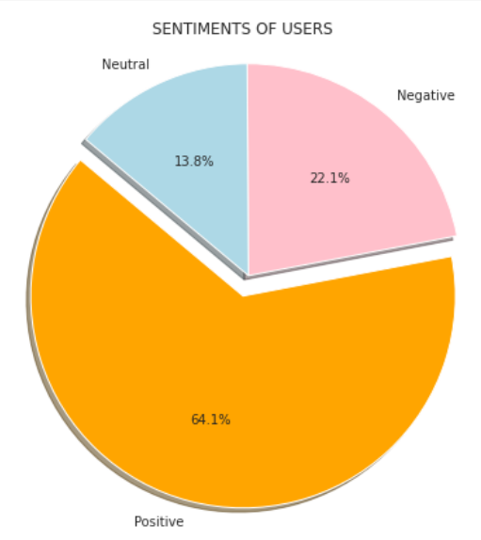
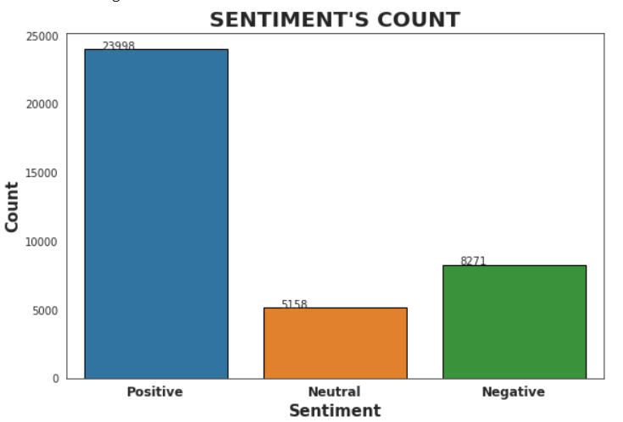
Sentiments Of Users & Sentiments Counts
Most of the sentiments users are positive and having review percent of 64.1
Also the high counts of sentiments are positive of 23998.

Slide 25
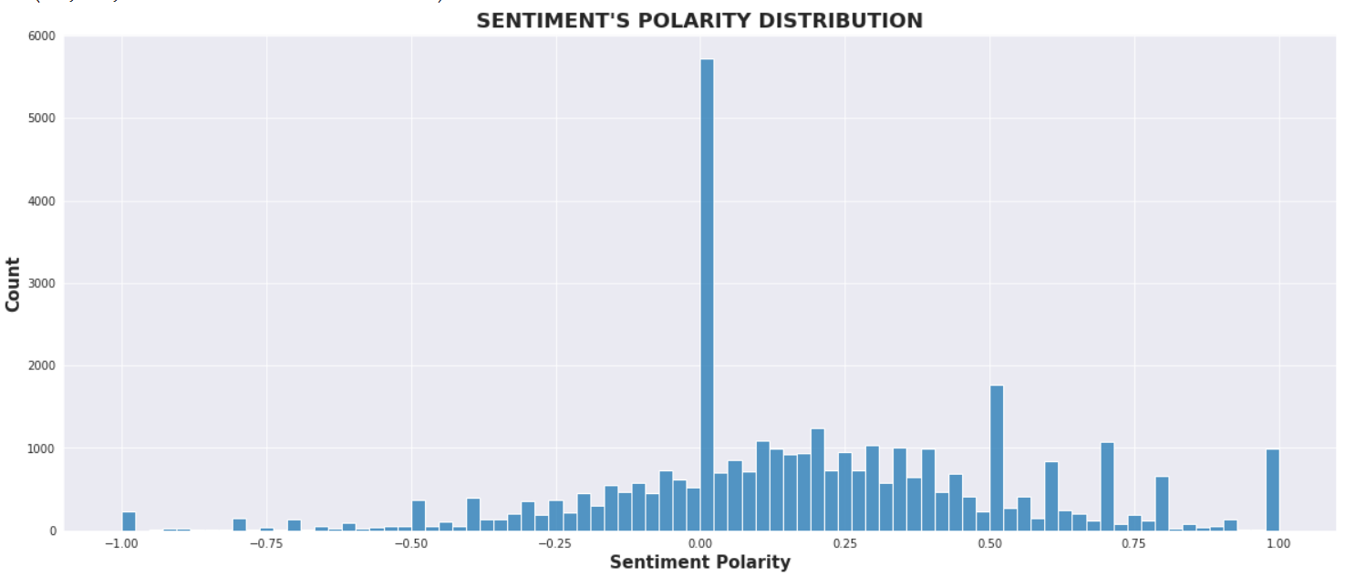
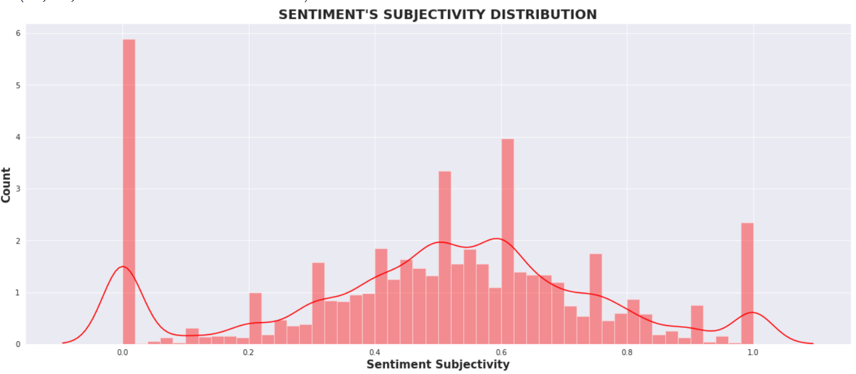
Sentiment Polarity Distribution & Sentiment Subjectivity Distribution
Sentiment Polarity is a ﬂoat which lies in the range of [-1,1] In this plot the maximum no. of positive reviews lies between 0 to 0.5.
Sentiment Subjectivity generally lies in the range of [0,1] In that maximum no. of sentiment subjectivity lies between 0.4 to 0.8.

Slide 26
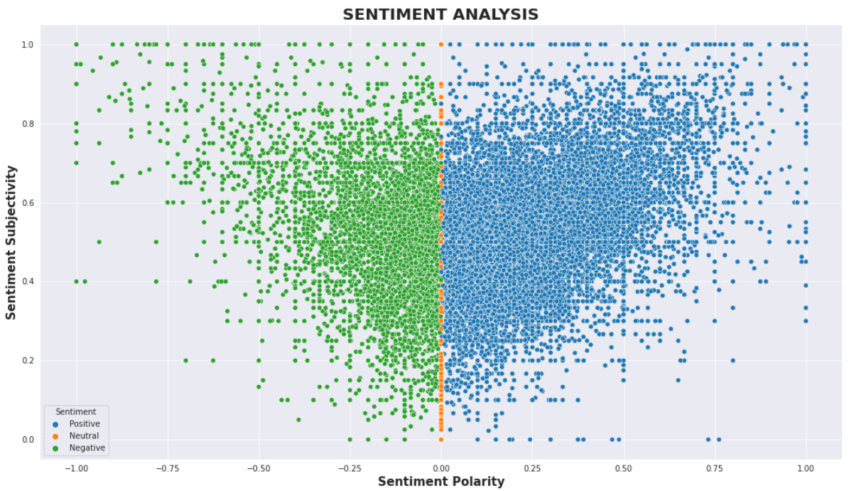
Sentiment Analysis on Polarity & Subjectivity
From the given scatter plot it can be concluded that sentiment subjectivity is not always proportional to sentiment polarity but in some number of case Sentiment Subjectivity proportional to Sentiment Polarity.

Slide 27
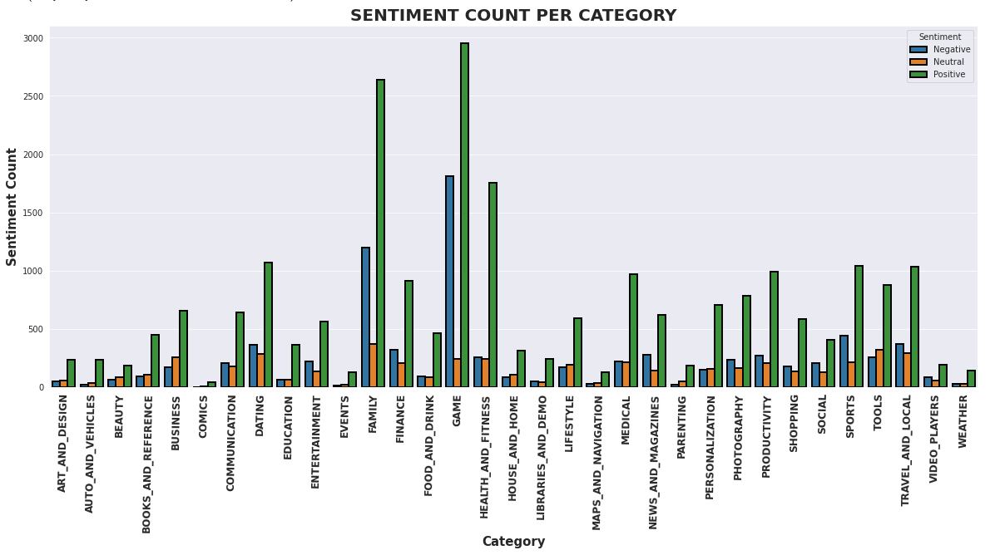
Sentiment Analysis on different Category basis
As we can see in bar chart maximum number of positive category are Games, Family & Health and fitness.
And we can say the maximum number of negative category are Dating, Tools, Family & Travel and Local.

Slide 28
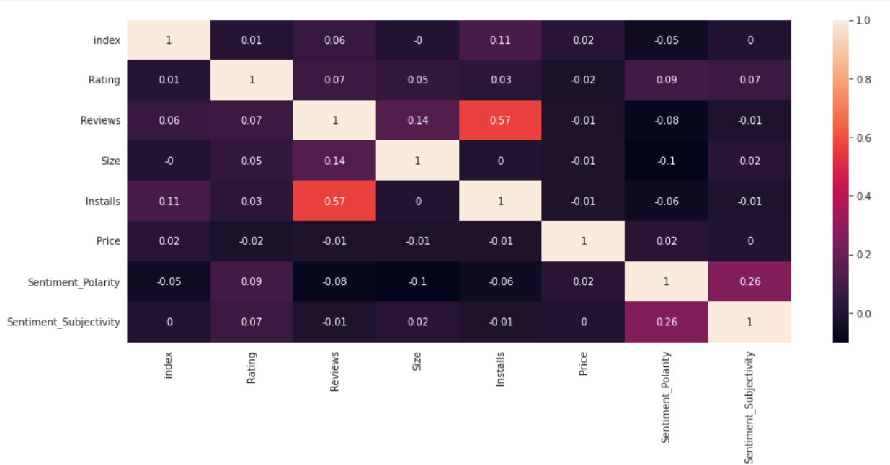
Correlation of Merged Dataset
The Correlation tells us how much does one variable changes for a slight change in another variable.
It may take positive, negative and zero values depending on the direction of the change.
We can see that installs and reviews have the strongest correlation.

Slide 29
Conclusion
The majority of users prefer free apps. The size of the app does not directly affect their decision to use paid or free apps.
The highest number of apps have been published in the Family, Games, and Tools categories on the Play store, but the highest number of installations have come from the Games category.
The apps which have the ratings above 4, are actually targeting all the people and not a certain age group.
Dating, Maps, Travel and Video Player are the categories which have received the lowest ratings from the user and we know that these apps have high human interaction.
On average the application size is in between 10 MB to 30 MB.
Medical, Family, game, Tools apps are the expensive apps.
This helps us to understand the application market and tells us as to which would be the right category to invest money to make good profits.
The sentiment does not influence the final rating of the apps because of the proportional behavior.
Popular categories have a more positive sentiment.
Positive reviews are higher than negative and neutral but the sentiment subjectivity is not always. proportional to sentiment polarity.
The pie chart of review sentiments and observe that the percentage of positive sentiments is near about 64%.
Graph of sentiment subjectivity and observe the maximum number of sentiment subjectivity lies between 0.4 to 0.8. From this we can conclude that the maximum number of users give reviews to the applications, according to their experience.

Slide 30

THANK YOU

